Slide 1
Strava, EDA, and Me
Making all those activity logs more useful

Slide 2
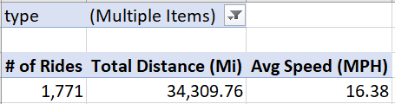
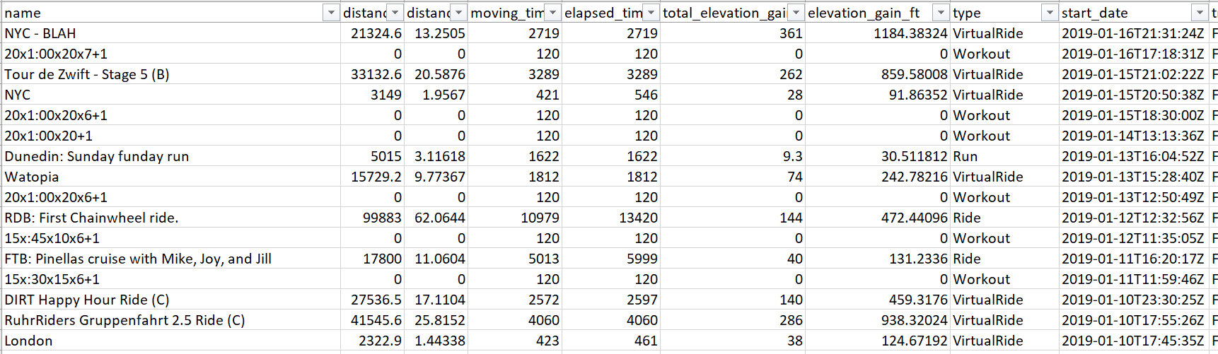
01. Statistical Question / Hypothesis
Which factor(s) have the greatest impact on average cycling speed over time?

Slide 3
02. A minimum of 5 variables in your dataset used during your analysis. Consider what you think could have an impact on your question.
type – this specifies the type of activity; there are 14 categories including ‘VirtualRide’, ‘Ride’, ‘Run’, and ‘Swim’
distance_mi – the distance traveled in miles
moving_time – the number of minutes moving (versus elapsed)
total_elevation_gain – the amount of climbing (in feet) for an activity
gear_id – the gear used (e.g., which bike or running shoe)
avg_speed_mph – the average speed for a given activity
average_watts – for cycling, the average power produced for a given activity, measured in watts
average_heartrate – how fast my heart was beating on average
average_temperature – in degrees Celsius

Slide 4
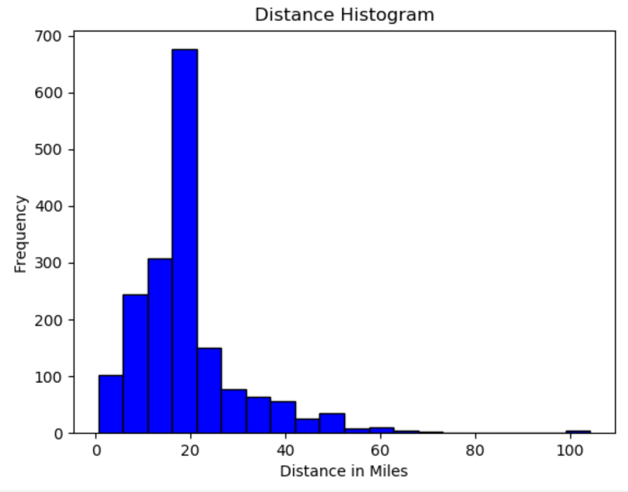
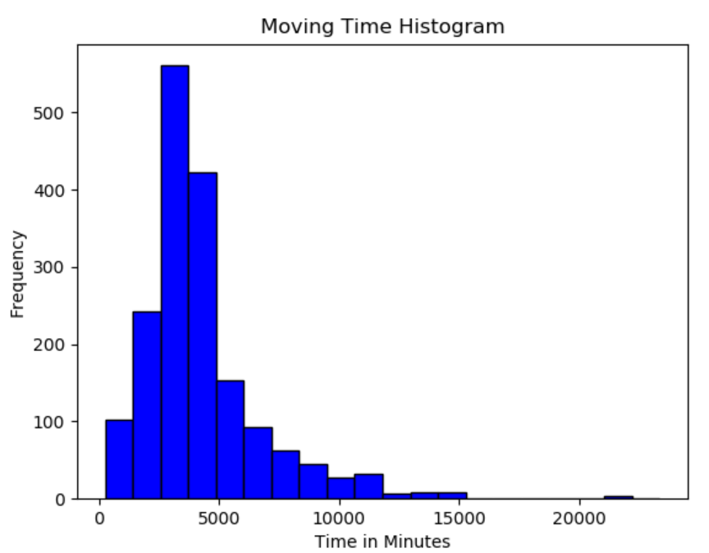
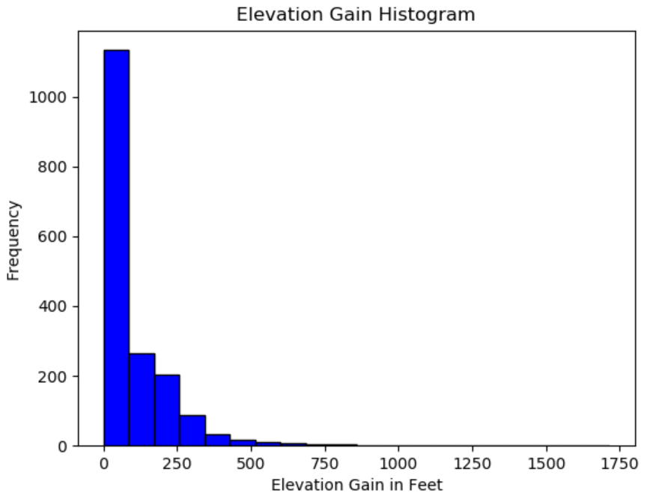
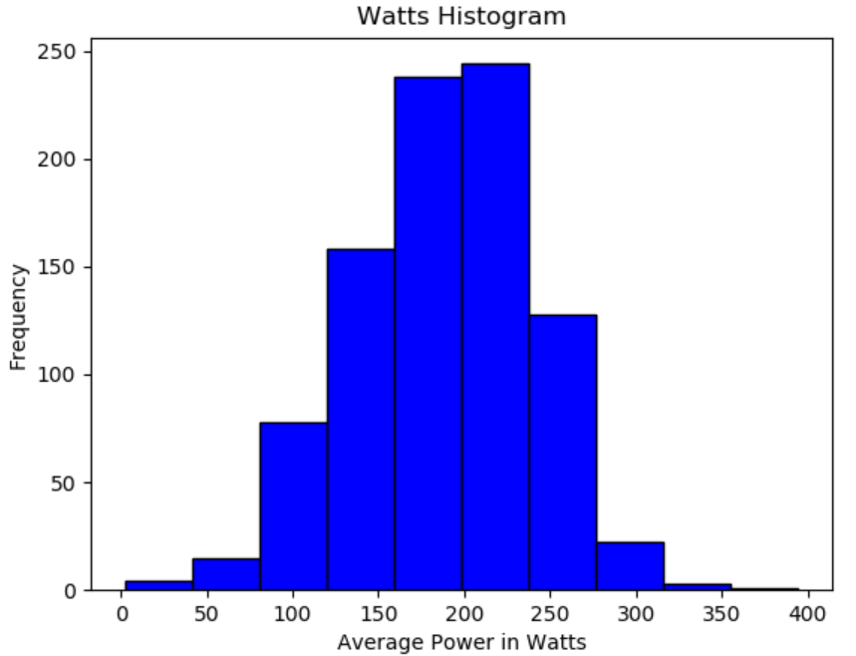
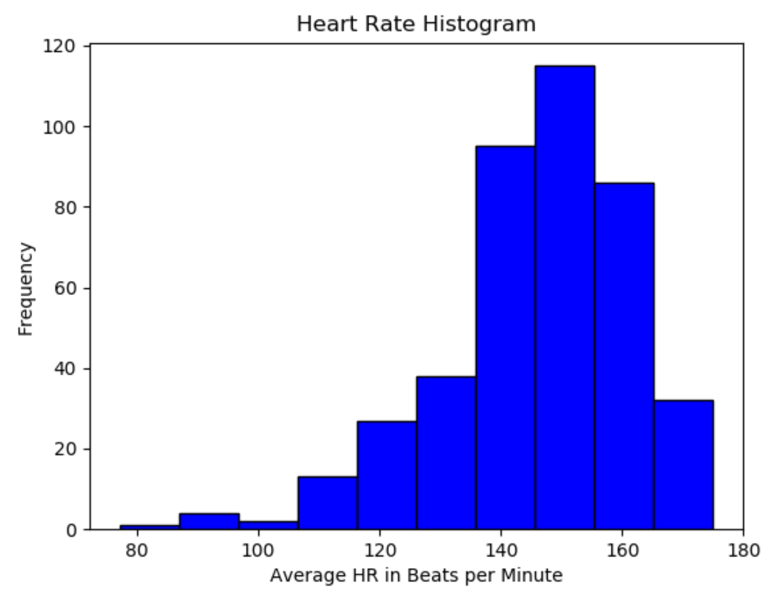
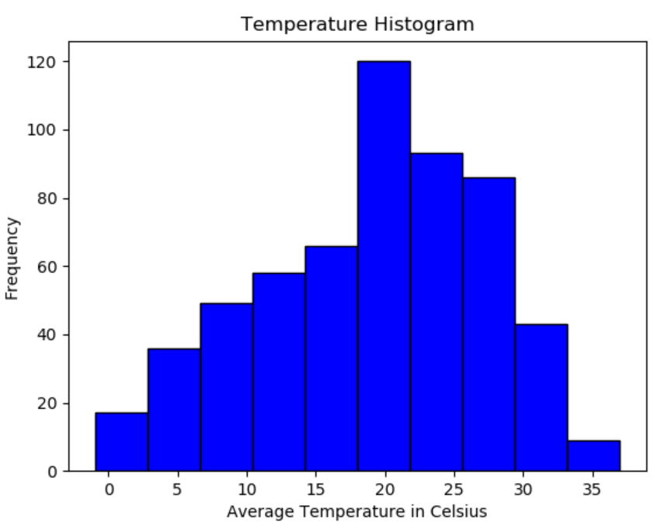
Include a histogram of each of the variables.
In your summary and analysis, identify any outliers and explain the reasoning for them being outliers and how you believe they should be handled.

Slide 5
In your summary and analysis, identify any outliers and explain the reasoning for them being outliers and how you believe they should be handled.

